Slide 1
Estimating Parameters and Determining Sample Sizes
7−1 Estimating a Population Proportion

Slide 2
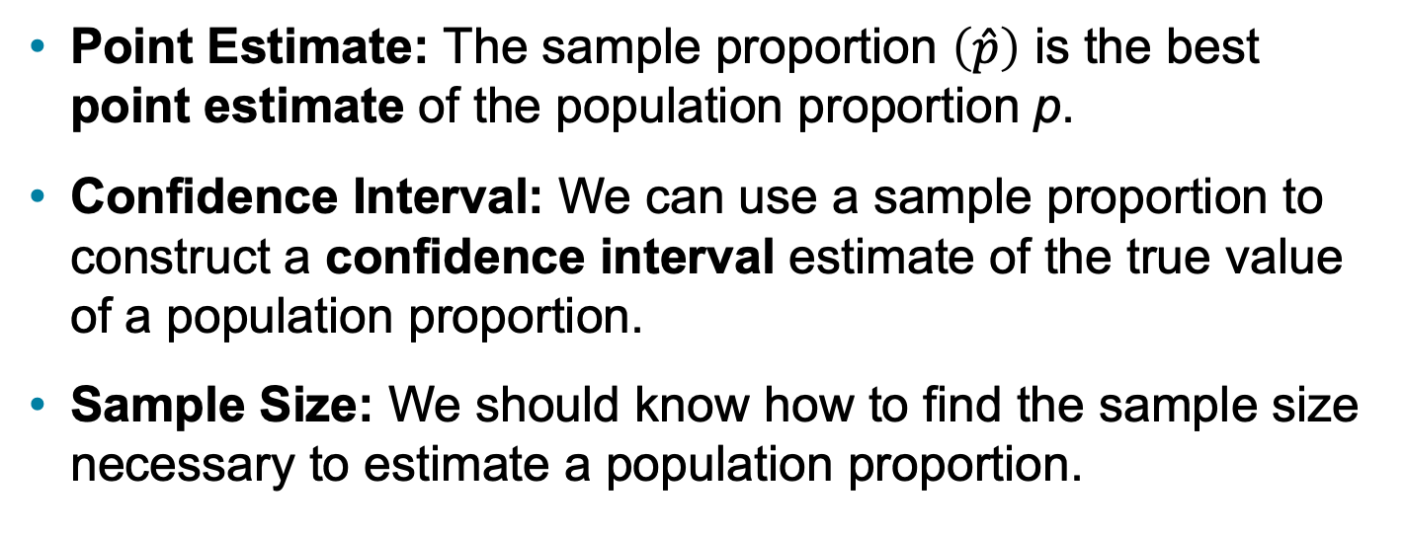
Key Concept
This section presents methods for using a sample proportion to make an inference about the value of the corresponding population proportion. Here are the three main concepts included in this section:
Point Estimate: The sample proportion $\left(\hat{p}\right)$ is the best point estimate of the population proportion p.
Confidence Interval: We can use a sample proportion to construct a confidence interval estimate of the true value of a population proportion.
Sample Size: We should know how to find the sample size necessary to estimate a population proportion.

Slide 3
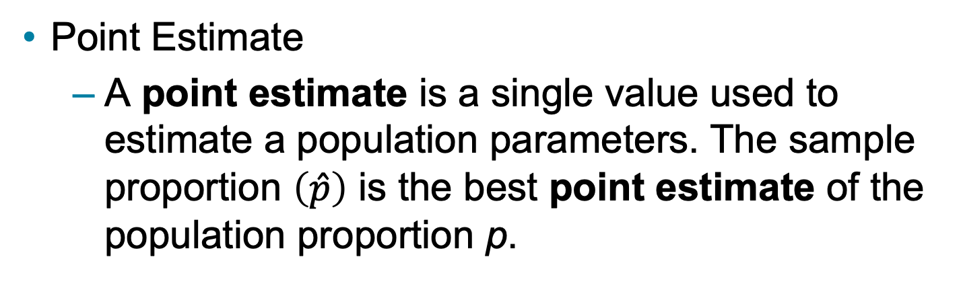
Point Estimate (1 of 2)
Point Estimate
A point estimate is a single value used to estimate a population parameters. The sample proportion $\left(\hat{p}\right)$ is the best point estimate of the population proportion p.

Slide 4
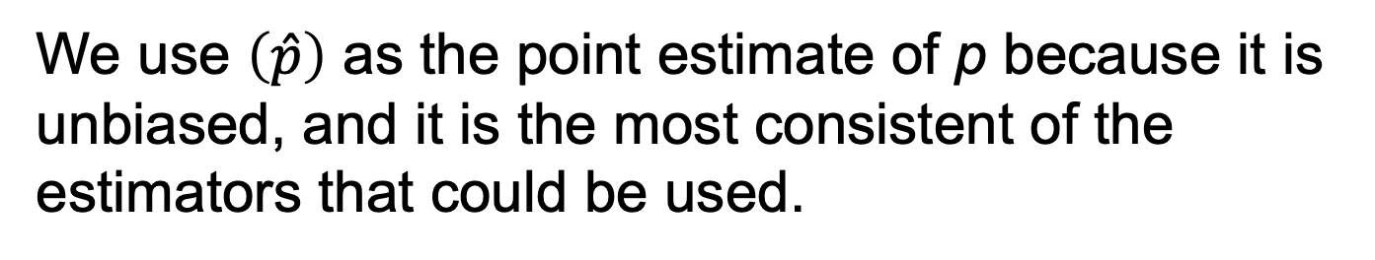
Point Estimate (2 of 2)
We use $\left(\hat{p}\right)$ as the point estimate of p because it is unbiased, and it is the most consistent of the estimators that could be used.
An unbiased estimator is a statistic that targets the value of the corresponding population parameter in the sense that the sampling distribution of the statistic has a mean that is equal to the corresponding population parameter.
The statistic $\hat{p}$ targets the population proportion p.

Slide 5
Example: Online Course (1 of 2)
The Chapter Problem included reference to a Sallie Mae survey of 950 undergraduate college students, and 53% of them said that they take online courses. Based on that result, find the best point estimate of the proportion of all undergraduate college students who take online courses.

Slide 7
Example: Online Course (2 of 2)
Solution
Because the sample proportion is the best point estimate of the population proportion, we conclude that the best point estimate of p is 0.53. (If using the sample results to estimate the percentage of all undergraduate college students who take online courses, the best point estimate is 53%.)

Slide 8
Confidence Interval
A confidence interval (or interval estimate) is a range (or an interval) of values used to estimate the true value of a population parameter. A confidence interval is sometimes abbreviated as CI.

Slide 9
Confidence Level
The confidence level is the probability 1 − α (such as 0.95, or 95%) that the confidence interval actually does contain the population parameter, assuming that the estimation process is repeated a large number of times. (The confidence level is also called the degree of confidence, or the confidence coefficient.)

Slide 10
Relationship Between Confidence Level and α
The following table shows the relationship between the confidence level and the corresponding value of α. The confidence level of 95% is the value used most often.
Most Common Confidence Levels | Corresponding Values of α
90% (or 0.90) confidence level: | α = 0.10
95% (or 0.95) confidence level: | α = 0.05
99% (or 0.99) confidence level: | α = 0.01

Slide 11
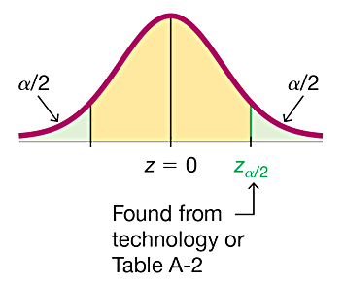
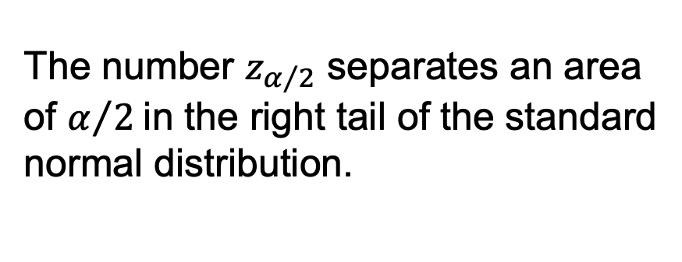
Critical Values
For the standard normal distribution, a critical value is a z score on the borderline separating those z scores that are significantly high or low from those that are not significant.
The number $z_{α/2}$ separates an area of $α/2$in the right tail of the standard normal distribution.

Slide 12
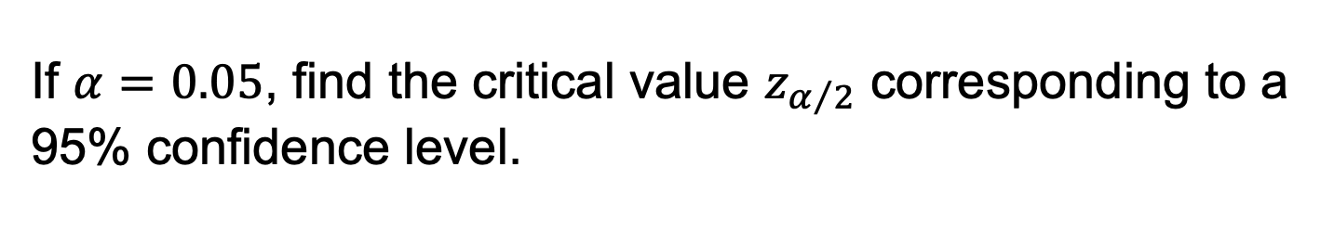
Finding a Critical Value (1 of 2)
If $α=0.05$, find the critical value $z_{α/2}$ corresponding to a 95% confidence level.
Note that when finding the critical z score for a 95% confidence level, we use a cumulative left area of 0.9750 (not 0.95). Think of it this way:

Slide 13
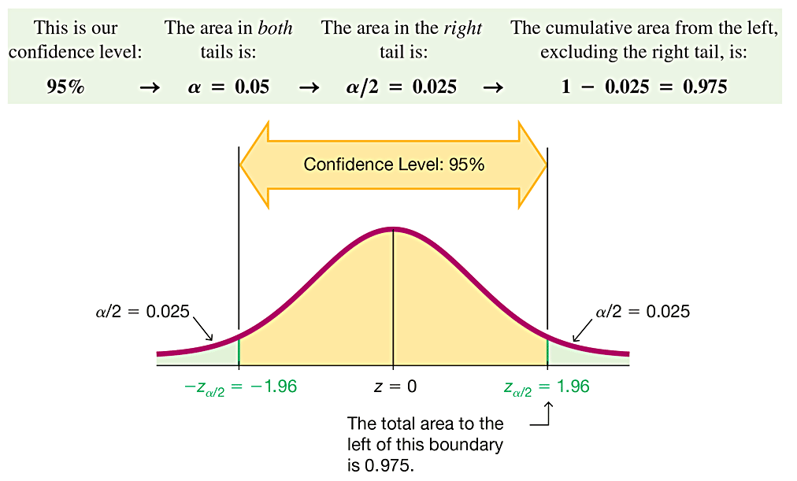
Finding a Critical Value (2 of 2)

Slide 14
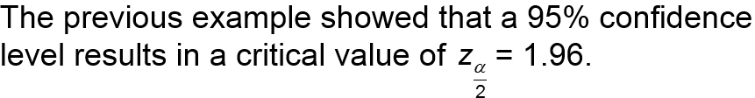
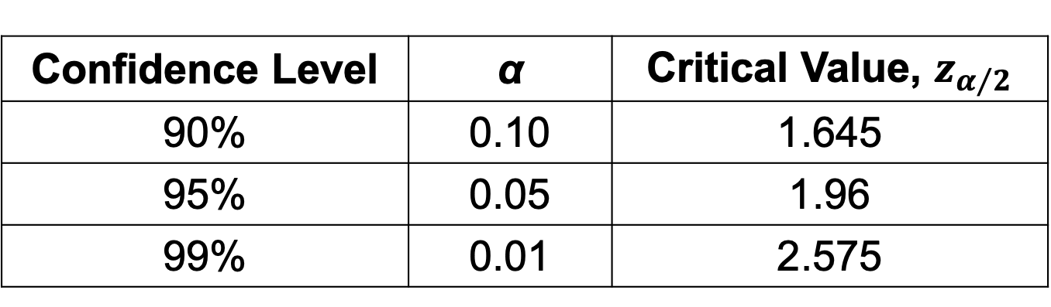
Common Critical Values
This is the most common critical value, and it is listed with two other common values in the table.
Confidence Level | α | Critical Value, $z_{α/2}$
90% | 0.10 | 1.645
95% | 0.05 | 1.96
99% | 0.01 | 2.575

Slide 15
Margin of Error
When using a sample statistic to estimate a population parameter, the margin of error, denoted by E, is the maximum likely amount of error (the amount by which the sample statistic misses the population parameter).
The margin of error E is also called the maximum error of the estimate and can be found by multiplying the critical value and the estimated standard deviation of sample proportions.

Slide 16
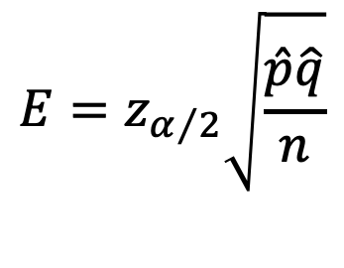
Margin of Error E for Proportions
Formula
$$E=z_{α/2}\sqrt{\frac{\hat{p}\hat{q}}{n}}$$
Critical value
Estimated standard deviation of sample proportions
Wald Confidence Interval When constructing a confidence interval using the margin of error E given in the Formula, the result is called a Wald confidence interval. Part 2 of this section will discuss other methods for constructing a confidence interval.

Slide 17
Interpreting a Confidence Interval (1 of 3)
We must be careful to interpret confidence intervals correctly. There is a correct interpretation and many different and creative incorrect interpretations of the confidence interval 0.405 < p < 0.455.
Correct: “We are 95% confident that the interval from 0.405 to 0.455 actually does contain the true value of the population proportion p.”

Slide 18
Interpreting a Confidence Interval (2 of 3)
We must be careful to interpret confidence intervals correctly. There is a correct interpretation and many different and creative incorrect interpretations of the confidence interval 0.405 < p < 0.455.
Wrong: “There is a 95% chance that the true value of p will fall between 0.405 and 0.455.”

Slide 19
Interpreting a Confidence Interval (3 of 3)
We must be careful to interpret confidence intervals correctly. There is a correct interpretation and many different and creative incorrect interpretations of the confidence interval 0.405 < p < 0.455.
Wrong: “95% of sample proportions will fall between 0.405 and 0.455.”

Slide 20
Confidence Interval for Estimating a Population Proportion p
Objective
Construct a confidence interval used to estimate a population proportion p.

Slide 21
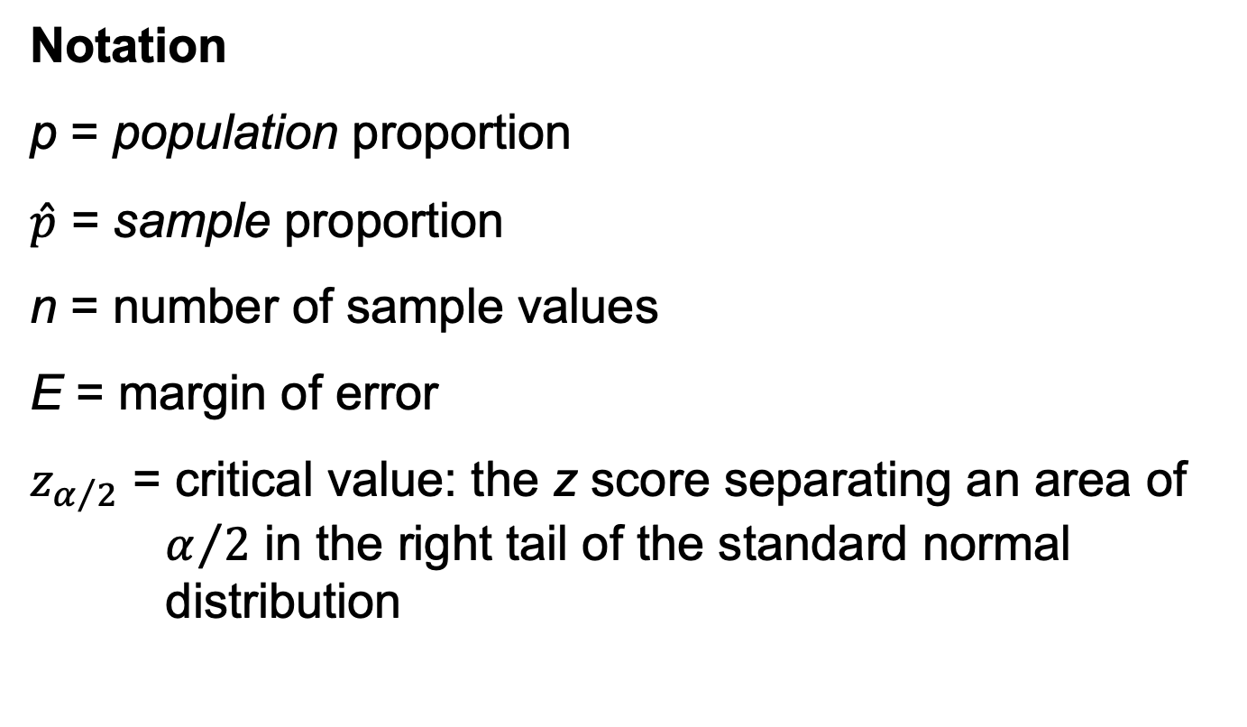
Confidence Interval for Estimating a Population Proportion p
Notation
p = population proportion
$\hat{p}$ = sample proportion
n = number of sample values
E = margin of error
$z_{α/2}$ = critical value: the z score separating an area of $α/2$ in the right tail of the standard normal distribution

Slide 22
Confidence Interval for Estimating a Population Proportion p
Requirements
The sample is a simple random sample.
The conditions for the binomial distribution are satisfied: There is a fixed number of trials, the trials are independent, there are two categories of outcomes, and the probabilities remain constant for each trial.
There are at least 5 successes and at least 5 failures.

Slide 23
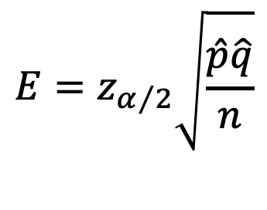

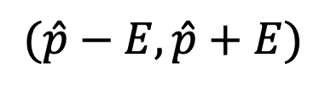

Confidence Interval for Estimating a Population Proportion p
Confidence Interval Estimate of p
$$E=z_{α/2}\sqrt{\frac{\hat{p}\hat{q}}{n}}$$
$$\hat{p}−E<p<\hat{p}+E$$
where
The confidence interval is often expressed in the following formats:
$$\hat{p}±E$$
or
$$(\hat{p}−E, \hat{p}+E)$$

Slide 24
Confidence Interval for Estimating a Population Proportion p
Round−Off Rule for Confidence Interval Estimates of p
Round the confidence interval limits for p to three significant digits.

Slide 25
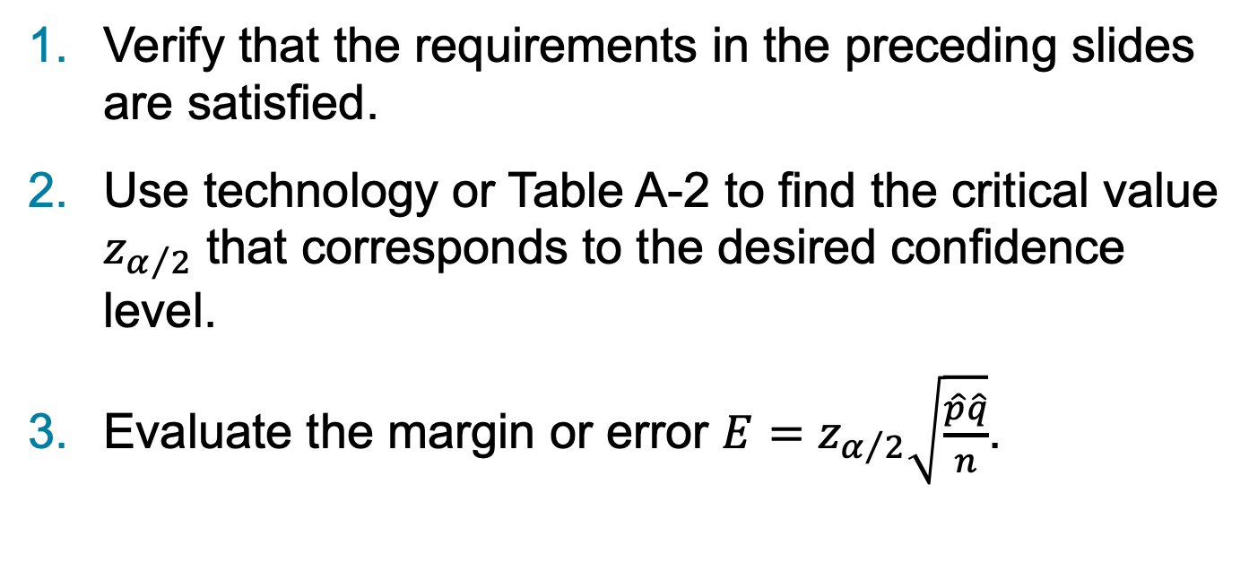
Procedure for Constructing a Confidence Interval for p (1 of 2)
Verify that the requirements in the preceding slides are satisfied.
Use technology or Table A-2 to find the critical value $z_{α/2}$ that corresponds to the desired confidence level.
Evaluate the margin or error $E=z_{α/2}\sqrt{\frac{\hat{p}\hat{q}}{n}}$.

Slide 26
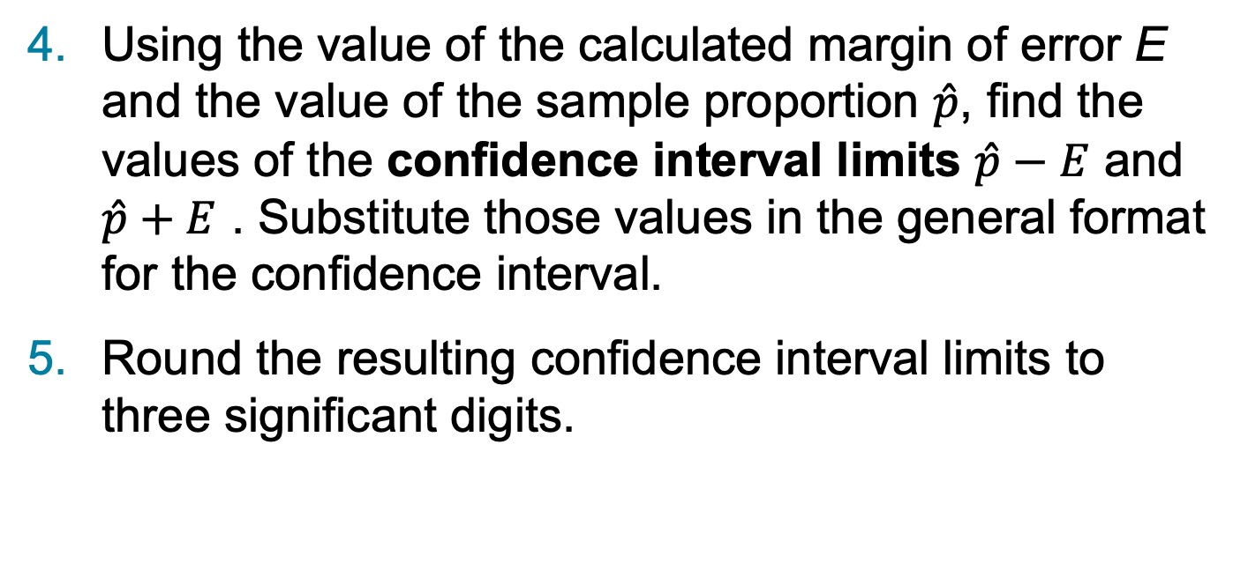
Procedure for Constructing a Confidence Interval for p (2 of 2)
Using the value of the calculated margin of error E and the value of the sample proportion $\hat{p}$, find the values of the confidence interval limits $\hat{p}−E$ and $\hat{p}+E$ . Substitute those values in the general format for the confidence interval.
Round the resulting confidence interval limits to three significant digits.

Slide 27
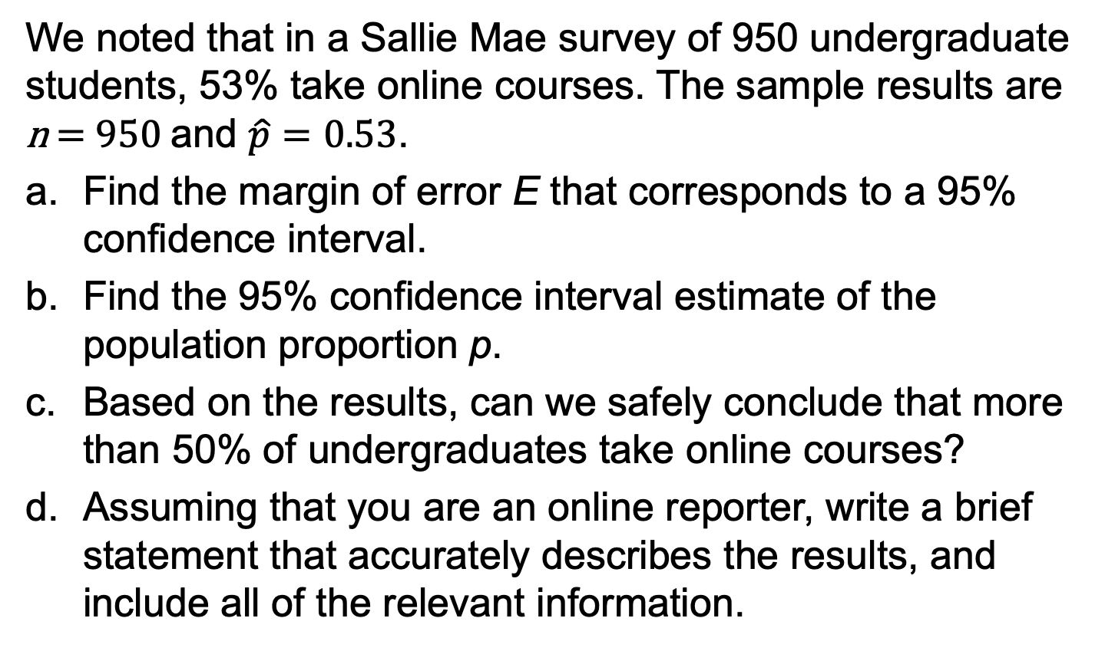
Example: Constructing a Confidence Interval: Online Courses (1 of 9)
We noted that in a Sallie Mae survey of 950 undergraduate students, 53% take online courses. The sample results are n = 950 and $\hat{p}=0.53$.
Find the margin of error E that corresponds to a 95% confidence interval.
Find the 95% confidence interval estimate of the population proportion p.
Based on the results, can we safely conclude that more than 50% of undergraduates take online courses?
Assuming that you are an online reporter, write a brief statement that accurately describes the results, and include all of the relevant information.

Slide 28
Example: Constructing a Confidence Interval: Online Courses (2 of 9)
Requirement Check
(1) The polling methods used by the Sallie Mae organization result in samples that can be considered to be simple random samples.
(2) The conditions for a binomial experiment are satisfied because there is a fixed number of trials (950), the trials are independent (because the response from one undergraduate doesn’t affect the probability of the response from another undergraduate), there are two categories of outcome (an undergraduate either takes online courses or does not), and the probability remains constant, because P(undergraduate takes online courses) is fixed for a given point in time.

Slide 29
Example: Constructing a Confidence Interval: Online Courses (3 of 9)
Requirement Check
(3) With 53% of the 950 undergraduates taking online courses, the number taking online courses is 53% of 950, which is 504 (from 0.53 • 950). If 504 of the 950 undergraduates take online courses, the other 446 do not, so the number of “successes” (504) and the number of “failures” (446) are both at least 5, as required.
The check of requirements has been successfully completed.

Slide 30
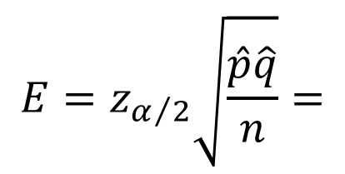
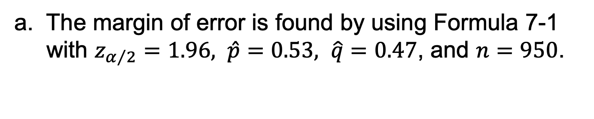
Example: Constructing a Confidence Interval: Online Courses (6 of 9)
Solution (Manual Calculation)
a. The margin of error is found by using Formula 7-1 with $z_{α/2}=1.96, \hat{p}=0.53, \hat{q}=0.47$, and $n=950$.
$$E=z_{α/2}\sqrt{\frac{\hat{p}\hat{q}}{n}}=$$

Slide 31
Example: Constructing a Confidence Interval: Online Courses (4 of 9)
Technology
The confidence interval and margin of error can be easily found using technology. From the Statdisk display on the next slide, we can see the required entries on the left and the results displayed on the right. Like most technologies, Statdisk requires a value for the number of successes, so we simply find 53% of 950 and round the result of 503.5 to the whole number 504. The results show that the margin of error is E = 0.03174 and the confidence interval is 0.499 < p < 0.562.

Slide 32
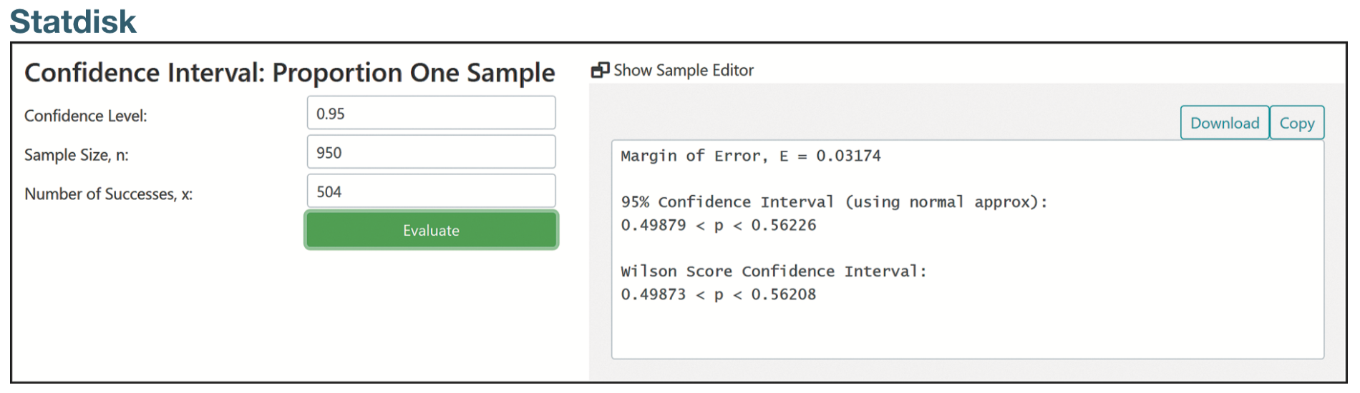
Example: Constructing a Confidence Interval: Online Courses (5 of 9)
Technology

Slide 33

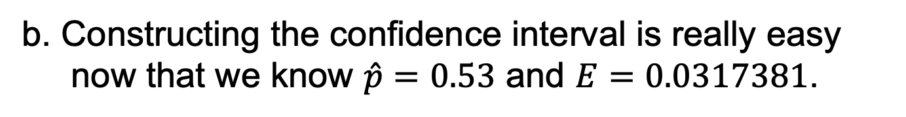
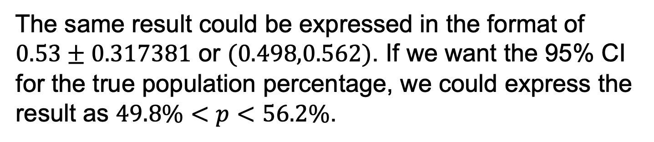

Example: Constructing a Confidence Interval: Online Courses (7 of 9)
Solution
b. Constructing the confidence interval is really easy now that we know $\hat{p}=0.53$ and $E=0.0317381$.
$$\hat{p}−E<p<\hat{p}+E$$
$$0.53−0.317381<p<0.53+0.317381$$
$$0.498<p<0.562$$
The same result could be expressed in the format of $0.53±0.317381$ or $(0.498,0.562)$. If we want the 95% CI for the true population percentage, we could express the result as $49.8\%<p<56.2\%$.

Slide 34
Example: Constructing a Confidence Interval: Online Courses (8 of 9)
Solution
c. Based on the confidence interval obtained in part (b), we cannot safely conclude that more than 50% of undergraduates take online courses. Because the confidence interval ranges from 0.498 to 0.562, it is possible that the population percentage is below 50%.

Slide 35
Example: Constructing a Confidence Interval: Online Courses (9 of 9)
Summary of results
Here is one statement that summarizes the results: 53% of undergraduates take online courses. That percentage is based on a Sallie Mae survey of 950 randomly selected undergraduates. In theory, in 95% of such polls, the percentage should differ by no more than 3.2 percentage points in either direction from the percentage that would be found by interviewing all undergraduates.

Slide 36
Analyzing Polls
When analyzing results from polls, consider the following:
The sample should be a simple random sample, not an inappropriate sample.
The confidence level should be provided.
The sample size should be provided.
Except for relatively rare cases, the quality of the poll results depends on the sampling method and the size of the sample, but the size of the population is usually not a factor.

Slide 37
Caution
Never think that poll results are unreliable if the sample size is a small percentage of the population size. The population size is usually not a factor in determining the reliability of a poll.

Slide 38
Finding the Point Estimate and E from a Confidence Interval
Point estimate of p:
$$\hat{p}=\frac{\text{(}\text{upp}\text{er} \text{confidence} \text{interval} \text{limit}\text{)}+\text{(}\text{lower} \text{confidence} \text{interval} \text{limit}\text{)}}{2}$$
Margin of error:
$$E=\frac{\text{(}\text{upp}\text{er} \text{confidence} \text{interval} \text{limit}\text{)}−\text{(}\text{lower} \text{confidence} \text{interval} \text{limit}\text{)}}{2}$$

Slide 39
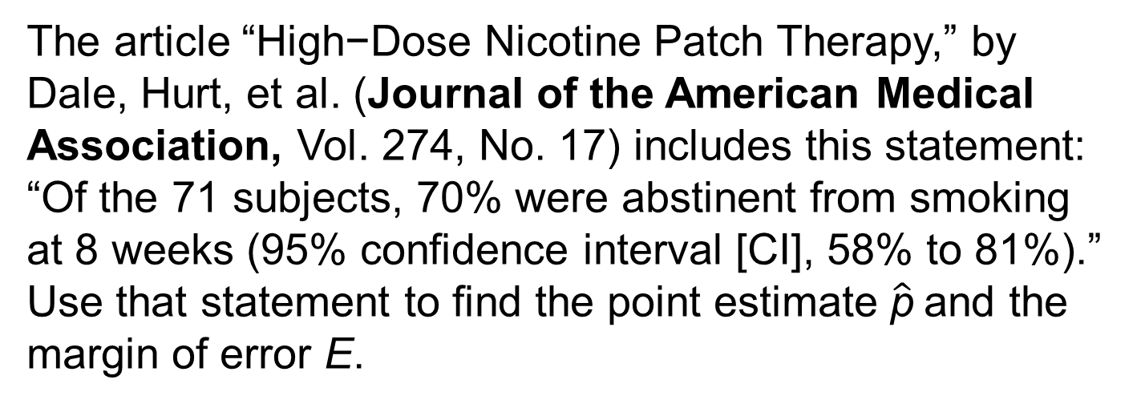
Example: Finding a Sample Proportion and Margin of Error (1 of 3)
The article “High−Dose Nicotine Patch Therapy,” by Dale, Hurt, et al. (Journal of the American Medical Association, Vol. 274, No. 17) includes this statement: “Of the 71 subjects, 70% were abstinent from smoking at 8 weeks (95% confidence interval [CI], 58% to 81%).” Use that statement to find the point estimate $\hat{\text{p}}$and the margin of error E.

Slide 40
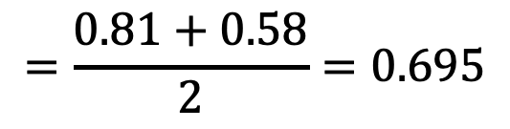
Example: Finding a Sample Proportion and Margin of Error (2 of 3)
Solution
We get the 95% confidence interval of 0.58 < p < 0.81 from the given statement of “58% to 81%.”
$$\hat{p}=\frac{\text{(}\text{upp}\text{er} \text{confidence} \text{interval} \text{limit}\text{)}+\text{(}\text{lower} \text{confidence} \text{interval} \text{limit}\text{)}}{2}$$
$$=\frac{\text{0.81}+\text{0.58}}{2}=0.695$$

Slide 41
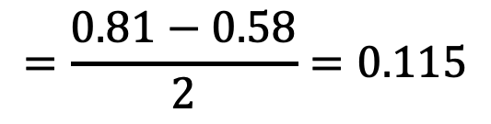
Example: Finding a Sample Proportion and Margin of Error (3 of 3)
Solution
The margin of error can be found as follows:
$$E=\frac{\text{(}\text{upp}\text{er} \text{confidence} \text{interval} \text{limit}\text{)}−\text{(}\text{lower} \text{confidence} \text{interval} \text{limit}\text{)}}{2}$$
$$=\frac{\text{0.81}−\text{0.58}}{2}=0.115$$

Slide 42
Determining Sample Size
When planning to collect sample data in order to estimate some population proportion p, we must first determine the sample size, which is the number of sample units that must be collected.

Slide 43
Finding the Sample Size Required to Estimate a Population Proportion
Objective
Determine how large the sample size n should be in order to estimate the population proportion p.

Slide 44
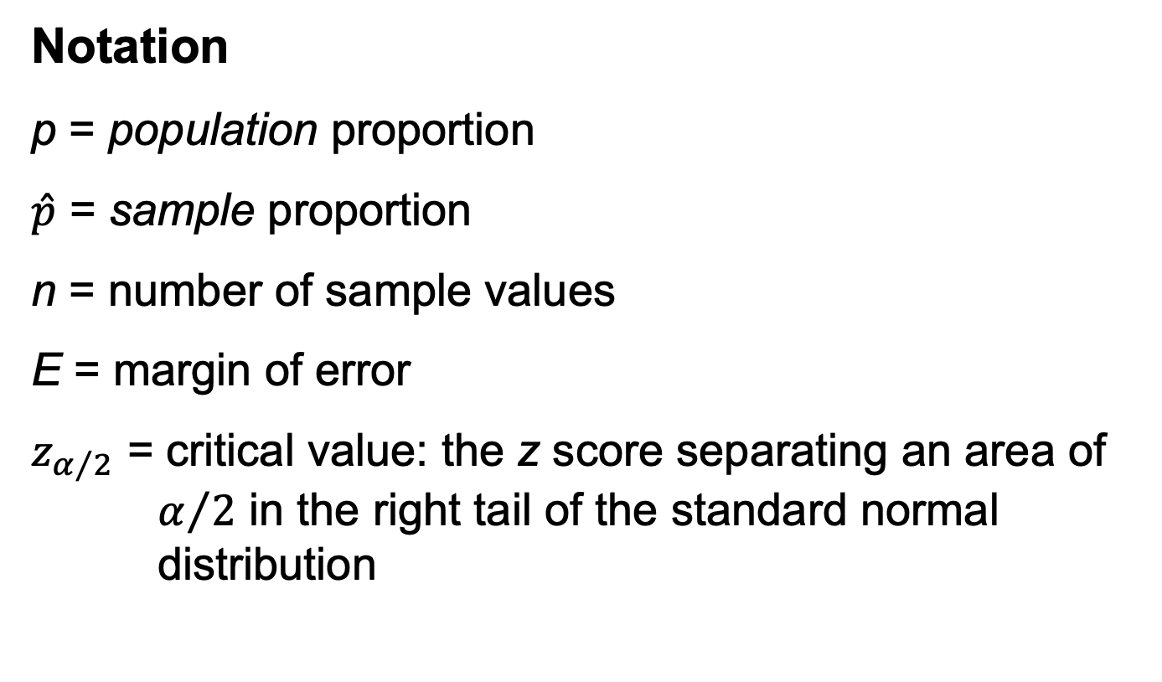
Finding the Sample Size Required to Estimate a Population Proportion
Notation
p = population proportion
$\hat{p}$ = sample proportion
n = number of sample values
E = margin of error
$z_{α/2}$ = critical value: the z score separating an area of $α/2$ in the right tail of the standard normal distribution

Slide 45
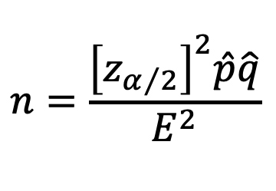

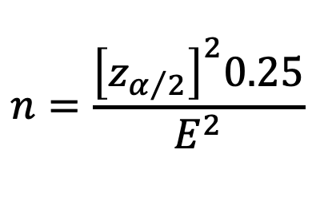

Finding the Sample Size Required to Estimate a Population Proportion
Requirements
The sample must be a simple random sample of independent sample units.
$$n=\frac{{\left[z_{α/2}\right]}^{2}\hat{p}\hat{q}}{E^{2}}$$
When an estimate of $\hat{p}$ is known:
$$n=\frac{{\left[z_{α/2}\right]}^{2}0.25}{E^{2}}$$
When no estimate of $\hat{p}$ is known:

Slide 46
Finding the Sample Size Required to Estimate a Population Proportion
Round-Off Rule for Determining Sample Size
If the computed sample size n is not a whole number, round the value of n up to the next larger whole number, so the sample size is sufficient instead of being slightly insufficient. For example, round 708.135 to 709.

Slide 47
Example: What Percentage of Adults Make Online Purchases? (1 of 4)
A 2016 Pew Research Center survey of 4787 randomly selected U.S. adults showed that 79% of the respondents shop online. If we want to conduct a new survey to determine whether that percentage has changed, how many adults must be surveyed in order to be 95% confident that the sample percentage is in error by no more than three percentage points?
a. Assume that 79% of adults make online purchases.
b. Assume that we have no prior information suggesting a possible value of the population proportion.

Slide 48
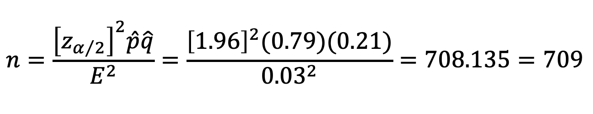
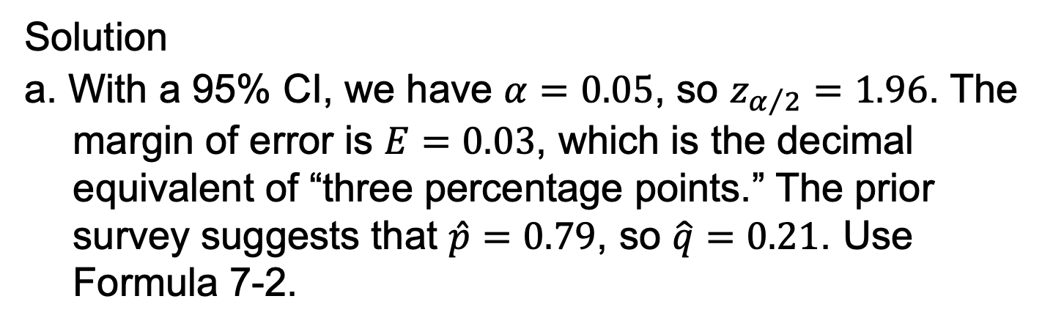
Example: What Percentage of Adults Make Online Purchases? (2 of 4)
Solution
a. With a 95% CI, we have $α=0.05$, so $z_{α/2}=1.96$. The margin of error is $E=0.03$, which is the decimal equivalent of “three percentage points.” The prior survey suggests that $\hat{p}=0.79$, so $\hat{q}=0.21$. Use Formula 7-2.
$$n=\frac{{\left[z_{α/2}\right]}^{2}\hat{p}\hat{q}}{E^{2}}=\frac{{\left[1.96\right]}^{2}(0.79)(0.21)}{{0.03}^{2}}=708.135=709$$
We must obtain a simple random sample that includes at least 709 adults.

Slide 49
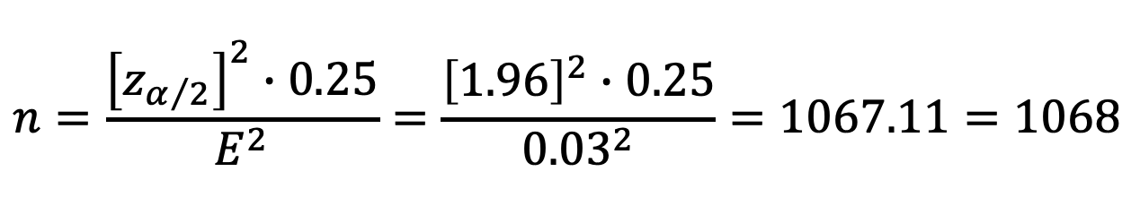
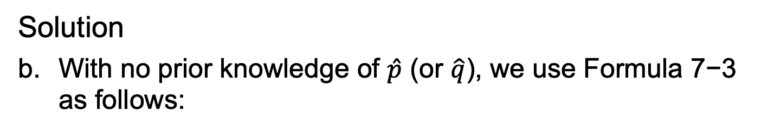
Example: What Percentage of Adults Make Online Purchases? (3 of 4)
Solution
With no prior knowledge of $\hat{p}$ (or $\hat{q}$), we use Formula 7−3 as follows:
$$n=\frac{{\left[z_{α/2}\right]}^{2}∙0.25}{E^{2}}=\frac{{\left[1.96\right]}^{2}∙0.25}{{0.03}^{2}}=1067.11=1068$$
We must obtain a simple random sample that includes at least 1068 adults.

Slide 50
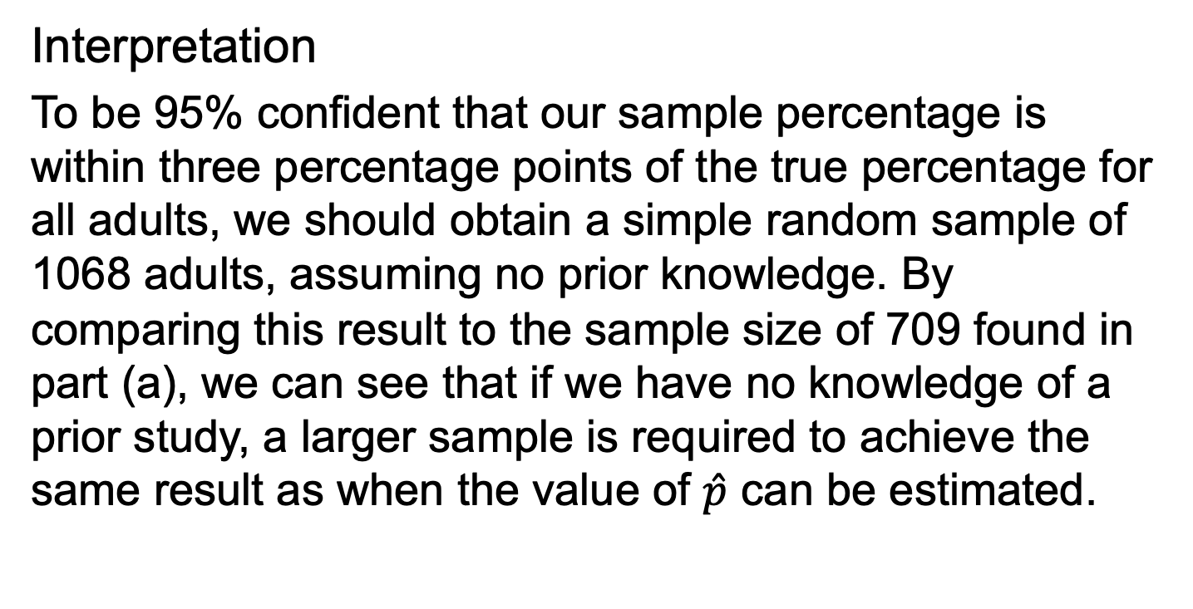
Example: What Percentage of Adults Make Online Purchases? (4 of 4)
Interpretation
To be 95% confident that our sample percentage is within three percentage points of the true percentage for all adults, we should obtain a simple random sample of 1068 adults, assuming no prior knowledge. By comparing this result to the sample size of 709 found in part (a), we can see that if we have no knowledge of a prior study, a larger sample is required to achieve the same result as when the value of $\hat{p}$ can be estimated.

Slide 51
Coverage Probability
DEFINITION
The coverage probability of a confidence interval estimate of the population proportion p is the actual proportion of such confidence intervals that contain the true population proportion.

Slide 52
Better Performing Confidence Intervals (1 of 3)
Plus Four Method
The plus four confidence interval performs better than the Wald confidence interval in the sense that its coverage probability is closer to the confidence level that is used.
The plus four confidence interval uses this very simple procedure: Add 2 to the number of successes x, add 2 to the number of failures (so that the number of trials n is increased by 4), and then find the Wald confidence interval as described in Part 1 of this section.

Slide 53
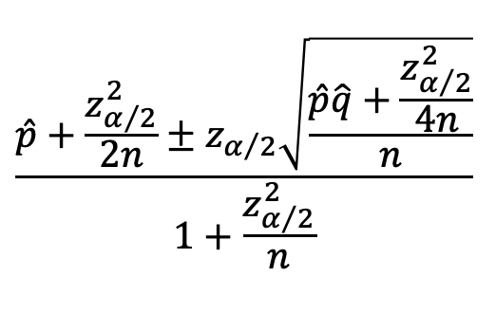
Better Performing Confidence Intervals (2 of 3)
Wilson Score
The Wilson score confidence interval performs better than the Wald CI in the sense that the coverage probability is closer to the confidence level. With a confidence level of 95%, the Wilson score confidence interval would get us closer to a 0.95 probability of containing the parameter p. However, given its complexity, it is easy to see why this superior Wilson score confidence interval is not used much in introductory statistics courses.
$$\frac{\hat{p}+\frac{z_{α/2}^{2}}{2n}±z_{α/2}\sqrt{\frac{\hat{p}\hat{q}+\frac{z_{α/2}^{2}}{4n}}{n}}}{1+\frac{z_{α/2}^{2}}{n}}$$

Slide 54
Better Performing Confidence Intervals (3 of 3)
Clopper−Pearson Method
The Clopper−Pearson method is an “exact” method in the sense that it is based on the exact binomial distribution instead of an approximation of a distribution. It is criticized for being too conservative in this sense: When we select a specific confidence level, the coverage probability is usually greater than or equal to the selected confidence level. Select a confidence level of 0.95, and the actual coverage probability is usually 0.95 or greater, so that 95% or more of such confidence intervals will contain p. Calculations with this method are too messy to consider here.

Slide 55
Which Method is Best?
There are other methods for constructing confidence intervals that are not discussed here. There isn’t universal agreement on which method is best for constructing a confidence interval estimate of p.
The Wald confidence interval is best as a teaching tool for introducing students to confidence intervals.
The plus four confidence interval is almost as easy as Wald and it performs better than Wald by having a coverage probability closer to the selected confidence level.

